Slide 1






Mission: To promote everyday wellness, plan for the future, and receive person centered care all through your life.
“It’s Your Health Care. It’s Your Choice.”
Honoring Choices Massachusetts
As a consumer-oriented nonprofit organization, we inform & empower adults to make a health care plan, and connect to quality care in their community.

Slide 2



Everyone Has Rights
“Every adult has the same general right
to be fully informed about their health care,
and to make choices about the care they want.”

Slide 3




Everyone Needs a Plan
We are all different. We make health care choices based on our medical status, family ties,
and personal values & beliefs, at different stages of life.
Everyone needs a plan for the best possible care at every stage of health.
© 2015 Honoring Choices Massachusetts, Inc.

Slide 4



‘Do-it-Yourself’ 3-Step Planning Guide for any age and any stage of health
How Do You Make a Plan?
Explore
Plan
Connect
Step 1
Make Choices
Step 2
Communicate Choices
Step 3
Honor Choices
© 2014 Honoring Choices Massachusetts, Inc.

Slide 5

Step 1
Explore: What’s Right for You?
Make Informed Choices
Consider Medical
Info & Options
Reflect Values & Beliefs
Know Your Rights
© 2015 Honoring Choices Massachusetts, Inc.

Slide 6
Plan
5 Massachusetts Planning Documents
Communicate Your Choices
Step 2
What’s in Your Plan?
1. Health Care Proxy
2. Personal Directive (Living Will)
3. Durable Power of Attorney
4. MOLST- Medical Orders for Life-Sustaining Treatment
CC/DNR- Comfort Care/Do Not Resuscitate Order

Slide 7

Massachusetts Health Care Proxy
“Who should I speak to about your care,
if I can not speak with you?”
What’s a Health Care Proxy ?
A simple legal document you can do yourself;
You choose a person you trust to talk with your care providers and make health care decisions, if you are not able to make decisions yourself;
© 2014 Honoring Choices Massachusetts, Inc.

Slide 8

“What instructions and information do you want to give your Health Care Agent about your care?”
Personal Directive or Living Will
Personal Directive or Living Will:
A personal document you do yourself;
You write down what’s important to you and your preferences and choices for care;
Not legally binding, but it’s your voice & your choice;
© 2014 Honoring Choices Massachusetts, Inc.

Slide 9

“Who do you want to make financial decisions for you if you can’t make financial decisions yourself?”
Massachusetts Durable Power of Attorney
Durable Power of Attorney:
A legal document you do with an attorney (recommended);
You choose a person you trust, Attorney-in-fact, to manage your money, property and financial matters if you become unable to effectively manage your financial matters yourself;
© 2014 Honoring Choices Massachusetts, Inc.

Slide 10

“If you have an advanced or terminal illness, what life-sustaining treatments would be acceptable to you?”
Medical Orders for Life-Sustaining Treatment or
MOLST form
Medical Orders for Life-Sustaining Treatment, MOLST :
A medical order & form you do with a physician, nurse practitioner or physician assistant;
You discuss your current medical condition and the use of life-sustaining treatments;
You make treatment choices and write your choices on the MOLST form;
Every person involved in your health care follows your decisions.
© 2014 Honoring Choices Massachusetts, Inc.

Slide 11

“Do you want medical personnel to restart your heart beat and breathing if your heart beat and breathing stop?”
Comfort Care/Do Not Resuscitate or
CC/DNR form
Comfort Care/Do Not Resuscitate, CC/DNR
A medical order & form you will out with your clinician
If your heart beat & breathing stop, you choose not
to have EMS ( Emergency Medical Service) or clinicians attempt to restart your heart beat & breathing;
EMS & Clinicians provide comfort care measures
© 2014 Honoring Choices Massachusetts, Inc.

Slide 12

Connect
Put Your Plan into Action with Care Providers to Honor Your Choices
Step 3
How am I feeling today?
• Talk about goals for care, diagnosis & treatment options.
Plan for the future.
• What’s ahead for you? Information to make choices
Write down your choices.
• Place Health Care Proxy in your medical record
Receive the Best Possible Care
• Clinicians match quality care to your choices all through your life.

Slide 13

Work in Partnership with Care Providers
To make the planning discussions “Known and Routine”
“5 Things to Talk About With
Your Care Providers”
“5 Things To Talk About With
Your Patients and Clients”
5 Things to Talk About with Care Providers
5 Things to Talk About with Patients and Clients

Slide 14
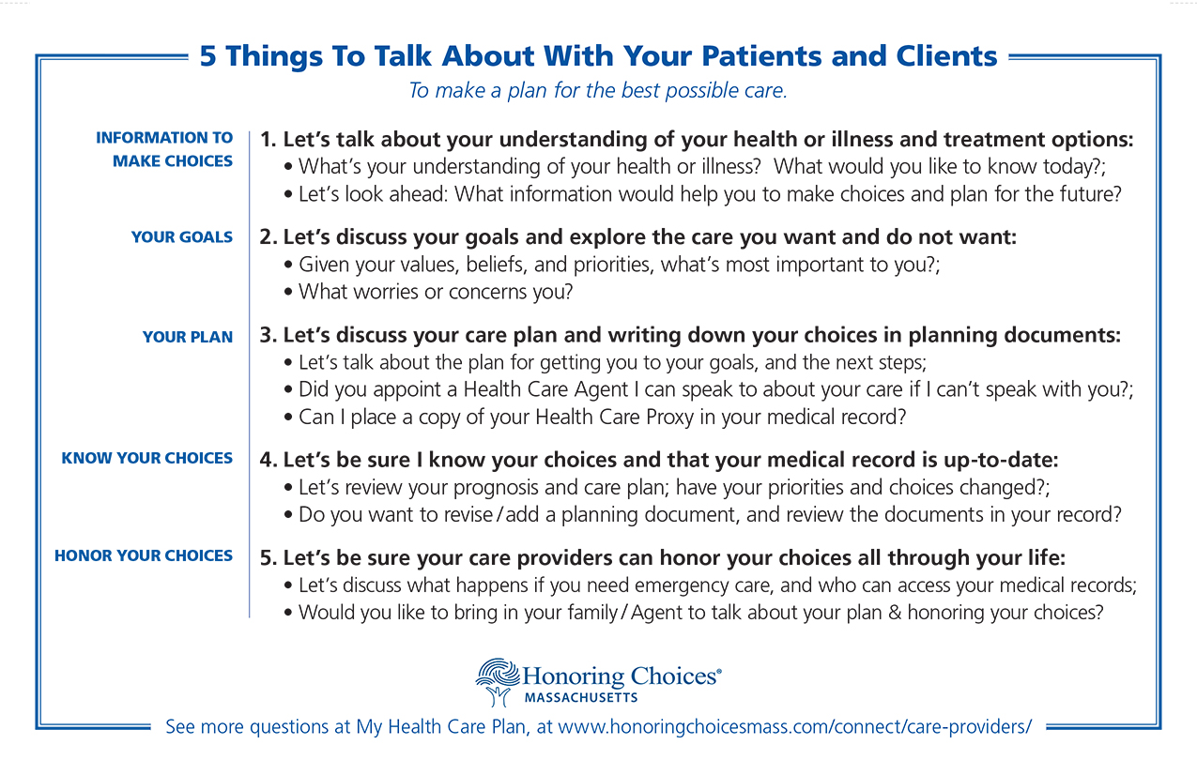
“5 Things To Talk About with Your Patients & Clients ”

Slide 15

Community Partners
Help Engage Adults in Planning Discussions and Connect to Quality Care
Primary Care
Community Services
Assisted Living & Home Care
Financial
&Legal
Hospice
Care Professionals
Hospitals
Health Systems
Faith & Culture

Slide 16

Alliance Partners
Support members with same Information, same tools
Mass Hospital Association
Mass
Senior Care Foundation
Blue Cross
Blue Shield
of MA
MA Coalition Prevention of Medical Errors
Atrius Health
Caregiver Homes/Seniorlink
MA Assisted Living Facilities Assoc.
Mass Home Care
Home Care Alliance of MA
LeadingAge Massachusetts
Hospice & Palliative Care Federation
NE QIN- QIO

Slide 17

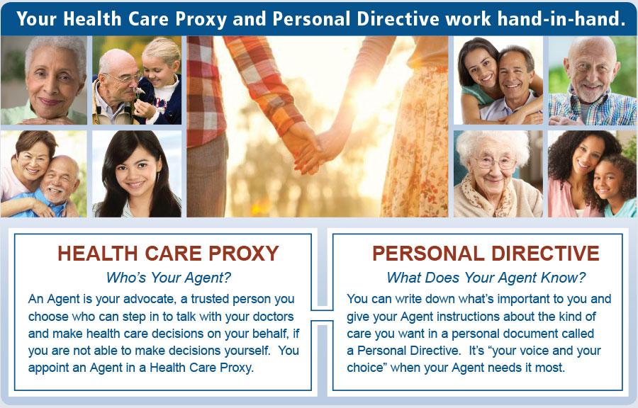
Celebrate April 11-16
National HealthCare Decisions Week

Slide 18

For more information visit our website at www.honoringchoicesmass.com or contact Ellen DiPaola, President
781-642-0454 edipaola@honoringchoicesmass.com
Thank you!

